Slide 1
Senior Year & Post Secondary Planning
Presentation by Teresa Dennis
LCVS Senior Advisor

Slide 2
Graduation: Class of 2023
Senior Brunch: February 21, 2023, 11:00-1:00pm
Graduation Rehearsal: May 18, 2:30-4:30pm at Chiles High Auditorium
Graduation: May 22, 6:00-8:00pm at Chiles
Graduation Requirements For Students Entering Grade Nine in the 2014-2015 School Year
https://www.fldoe.org/core/fileparse.php/7764/urlt/StandardDiplomaRequirements.pdf
Florida Literacy Exam – this is a must take exam that is taken senior year (no minimum score required; however, college students must pass this exam for completion of an A.A. or A.S. Degree)

Slide 3
FLDOE Academic Advisement Flyer

Slide 4
Standard Diploma Requirements: 24 credit diploma
4 credits in English
4 credit in Math to include Algebra I and Geometry
3 credits in Science to include Biology
3 credit in Social Science: World History, US History, Economics/US Government
1 credit in Fine/Approved Practical Art
1 credit in HOPE-PE
8 Elective Credits
2.00 unweighted Cumulative GPA
Pass Grade 10 FSA ELA
Pass Algebra EOC
Complete an online course

Slide 5
Standard Diploma Requirements: ACCEL diploma
4 credits in English
4 credit in Math to include Algebra I and Geometry
3 credits in Science to include Biology
3 credit in Social Science: World History, US History, Economics/US Government
1 credit in Fine/Approved Practical Art
3 Elective Credits
2.00 unweighted Cumulative GPA
Pass Grade 10 FSA ELA
Pass Algebra EOC

Slide 6
Options After High School
Work
Military: Active, Reserves,ROTC,Academy
Vocational School
Community College
University

Slide 7
Applying to College
Families should be able to answer the following questions for themselves:
Does your student like school? Have they been successful?
What institutions best fit the student’s academic and social interests and educational objectives?
How much is the family able to reasonably afford to help the student meet his or her educational goals?

Slide 8
Consider 2 to 6 Colleges
Freshman Retention Rate: how many students return after their freshmen year?
How big are freshmen classes?
6 yr Graduation rate?
Are freshman required to live in a dorm?
AP credit policies?
2 reaches
3 targets
1 safety
visit campus
with alumni
www.collegeweeklive.com

Slide 9
SAT Reasoning Test
www.sat.org/register
LCVS Code: 102628
SAT @ $55
Test Date: Nov. 5 / Registration by Oct. 7
Test Date: Dec. 3 / Registration by Nov. 3
Test Date Mar. 11 / Registration by Feb. 10
Fee Waivers available for eligible students
https://collegereadiness.collegeboard.org/sat/register/fees/fee-waivers - contact your counselor for assistance.

Slide 10
SAT Practice
Free Practice Questions , Practice Test and tutorials from Khan Academy
https://collegereadiness.collegeboard.org/sat/practice
https://www.khanacademy.org/sat

Slide 11
ACT
www.actstudent.org
LCVS School Code: 102628
ACT @ $60
ACT with Writing @ $85
Test Date: Oct. 22 / Registration by Sept. 16 (late registration open until Sept. 30th)
Test Date: Dec. 10 / Registration by Nov. 4
Test Date: Feb. 11 / Registration by Jan. 6
Fee Waiver eligibility https://www.act.org/content/act/en/products-and-services/the-act/registration/fees/fee-waivers.html
ACT online prep http://www.actstudent.org/testprep

Slide 12
State University System ( SUS)
Admissions Requirements:
https://www.floridashines.org/go-to-college/get-ready-for-college/college-admission-requirements

Slide 13
Applying to a State University
Transcripts vs SSAR
Application – Institution app vs Common App
Fee – credit card or fee waiver
LCVS CEEB # is 102628
Personal statement essays
Residency (since most students are “dependent”, the parent is the person claiming residency and must provide required documentation)
Tuition and Housing deposits

Slide 14
Florida Universities (not all)
Florida State Univ – Oct. 15
Univ. of Florida – Nov. 1
Univ. of West Fla.
Univ. of No. Fla.
Univ of So. Fla
Fla. Atlantic Univ.
New College
Fla. Gulf Coast Univ.
Fla. International Univ.
Fla. Polytechnic Univ
FAMU
Univ. of Central FL
Univ. of Miami
Flagler
Stetson
Eckerd
Univ. of Tampa
Jacksonville Univ.
Fl. Southern

Slide 15
Competitive Colleges
Grades & Curriculum
Extracurricular Activities
Leadership & Service
SAT II
Counselor & Teacher Recommendations – give at least 2 weeks notice
Use Common application
Early decision policies

Slide 16
Admission Advice
Apply early!
READ and SAVE all materials:
Tuition Deposit Deadlines
Housing Deposit
Orientation Deposit
Admission is based on satisfactory completion of senior year – CAN RESCIND ADMISSION for poor senior grades or dropped classes!

Slide 17
Community & State Colleges
Of 28 Community Colleges 18 have become State Colleges that offer 4-year degrees in some programs
Many of the Community Colleges offer degrees from partner universities (e.g. TCC has Flagler, St. Leo University)
They all have open enrollment (high school diploma required)

Slide 18
Community & State Colleges
Admission based on High School Diploma
Recommended test scores for College Success:
SAT: 24 Reading, 25 Writing/Lang, 24 Math
ACT: 17 English, 19 reading, 19 math
Students who take college prep courses in high school are more likely to be successful

Slide 19
Benefits of Community College
Class size, costs, teachers
Multiple degrees: AA, AS, Certificate
AA guarantees admission to SUS with 60 credit hours and junior standing (must meet requirements for specific majors)
Check out TCC2FSU and TCC2FAMU Programs and other Transfer Options at https://www.tcc.fl.edu/academics/transfer-options/

Slide 20
While final application deadline may not be until the summer, it is best to apply to TCC in December/January
http://www.tcc.fl.edu/admissions/apply/
Priority scholarship deadline is Feb. 15th
https://www.tcc.fl.edu/admissions/financial-aid/scholarships/
FAFSA opens Oct. 1st https://studentaid.gov/h/apply-for-aid/fafsa

Slide 21
Lively Technical Center
Lively offers numerous career certificate programs. For information on academic and career programs offered, go to
http://livelytech.com/

Slide 22
Financial Aid
FAFSA (Free Application for Federal Financial Aid) https://studentaid.gov/h/apply-for-aid/fafsa
Available October 1 and will use income information from two years prior to the academic year.
Utilize the IRS Data Retrieval Tool to make the process easier!

Slide 23
Net Price Calculator
The Net Price Calculator is used to help calculate the average award granted to students with similar family and financial circumstances. Please remember this is an average award.
All colleges should have the link on their websites!

Slide 24
Florida Bright Futures Scholarship Program
Can be used at any Florida public or private comm.college, university, or voc.school
Everyone who meets the criteria gets the money
4 ways to qualify:
Academic Scholars Award
Medallion Scholars Award
Gold Seal Vocational Scholars Award
Gold Seal CAPE Scholars

Slide 25
Academic Scholars Award **
3.5 weighted GPA (only .25 weight) on the 16 required credits - may use up to 2 additional credits in required subjects to raise GPA, and
1330 SAT or 29 ACT (writing sections will not be used), and
100 hours of community service or paid work
You can only choose one options for service hrs.
**SUBJECT TO LEGISLATIVE CHANGES

Slide 26
Medallion Scholars Award **
3.0 weighted GPA (only .25 weight) on the 16 required courses - may use up to 2 additional credits in required subjects to raise GPA, and
1210 SAT or 25 ACT (writing section will not be used)
75 hours of community service or 100 paid work hours (you may only choose one option)
**SUBJECT TO LEGISLATIVE CHANGES

Slide 27
Academic & Medallion Coursework
4 English
4 Mathematics
3 Sciences
3 Social Studies (any)
2 Foreign Language (in same language)
16 credits
BF GPA IS NOT THE LCVS GPA

Slide 28
Gold Seal Vocational Award
3.0 weighted GPA (only .25 weight) using the 16 credits required for graduation, and
3.5 unweighted GPA in a minimum of 3 sequential vocational credits
30 hours of community service or 100 paid work hours, and
College Entrance Exams:
PERT: 106 Reading, 103 Writing, 114 Math or
SAT: 24 Reading, 25 Writing/Language, 24 Math
or ACT: 17 English, 19 Reading, 19 Math
ONLY can be used for Career certificate & Applied Technology or Technical Programs

Slide 29
Gold Seal CAPE Scholars (GSC)
Earn a minimum of 5 postsecondary credit hours through CAPE industry certification which articulate for college credit
30 community service hours
Can be use to fund a career education or certificate program

Slide 30
Applying for Bright Futures
Apply online after October 1, 2022 but before high school graduation
https://www.floridastudentfinancialaidsg.org/home/ApplyHere.asp
7th semester evaluations –BEST TO QUALIFY EARLY!!
test scores through January
community service hours through Dec
8th semester
test scores through June
not to undo 7th semester award , CS by graduation

Slide 31
Best & Brightest Scholarship
The application for the Best and Brightest awards
and scholarship monies has opened. Please check out the informational flyer (link below) for the categories and scholarship awards at each level.
If you would like us to review your application
before the final submission please submit your
application and all documentation by Wednesday,
December 14th at 5:00 PM to Mrs. McGriff at the LCVS main office at 3955 West Pensacola Street – Aquilina Howell Building.
Note: Final School Nominations are due by 5:00pm on Jan. 27, 2022
For Questions: contact Mrs. McGriff at mcgrifft1@leonschools.net
Best and Brightest:
http://wcsleon.com/bestandbrightest

Slide 32
Stay informed – visit our website!
www.leongoesvirtual.net
CLICK ON Parents & Students for important announcements and dates; resources and videos
Under GUIDANCE: Links to Bright Futures Scholarship, SAT, ACT, NCAA, Financial Aid, College Admission Requirements and more!
Community Service Guidelines & Verification
Special Activities/Programs

Slide 33
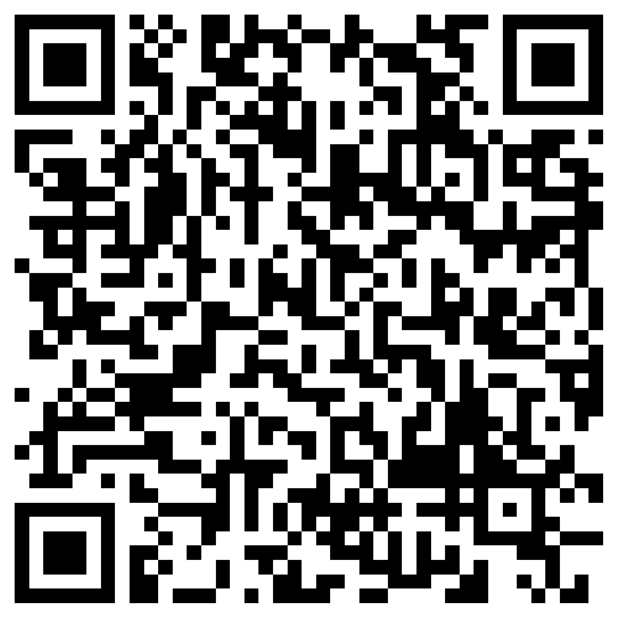
SENIOR SURVEY
Please complete the Senior Survey online
https://forms.office.com/r/DfXAfZLLPh
Or

Slide 34
Questions?
I am here to help students and parents plan for post-secondary options. Email me if you would like to set up an appointment.
Teresa Dennis 850-561-8365 or dennist@leonschools.net

